Slide 1
Sign up for our Cloud Skills Challenge! aka.ms/SouthCoast
Take part in our Cloud Skills Challenge and earn swag when you complete 3 modules or more. You'll also be entered into a prize draw to win Surface Prizes!
Swag & Prizes can be sent only to UK addresses.
Notes:
Please have this slide on display prior to your session beginning. Please make reference to the Cloud Skills Challenge.
A few minutes before your session begins, please then move to your ‘opening slide’.
Take part in our Cloud Skills Challenge and earn swag when you complete 3 modules or more.
You'll also be entered into a prize draw to win Surface Prizes!
Cloud Skills Challenge open until 15th November
Swag & Prizes can be sent only to UK addresses.

Slide 2
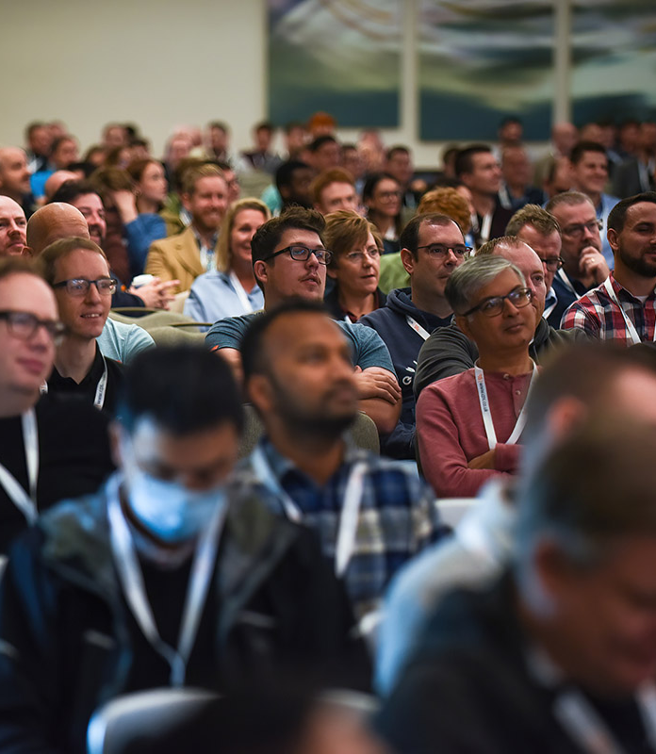
A deeper dive into dev containers for your project
Jess Pomfret
Rob Sewell
Notes:
MANDATORY SLIDE

Slide 3
Notes:
Mandatory slide. Please ensure you refer to our sponsors –
“Without their sponsorship, the event couldn’t happen. Please check them out in the Expo Hall”.

Slide 4
A deeper dive into dev containers for your project

Slide 5

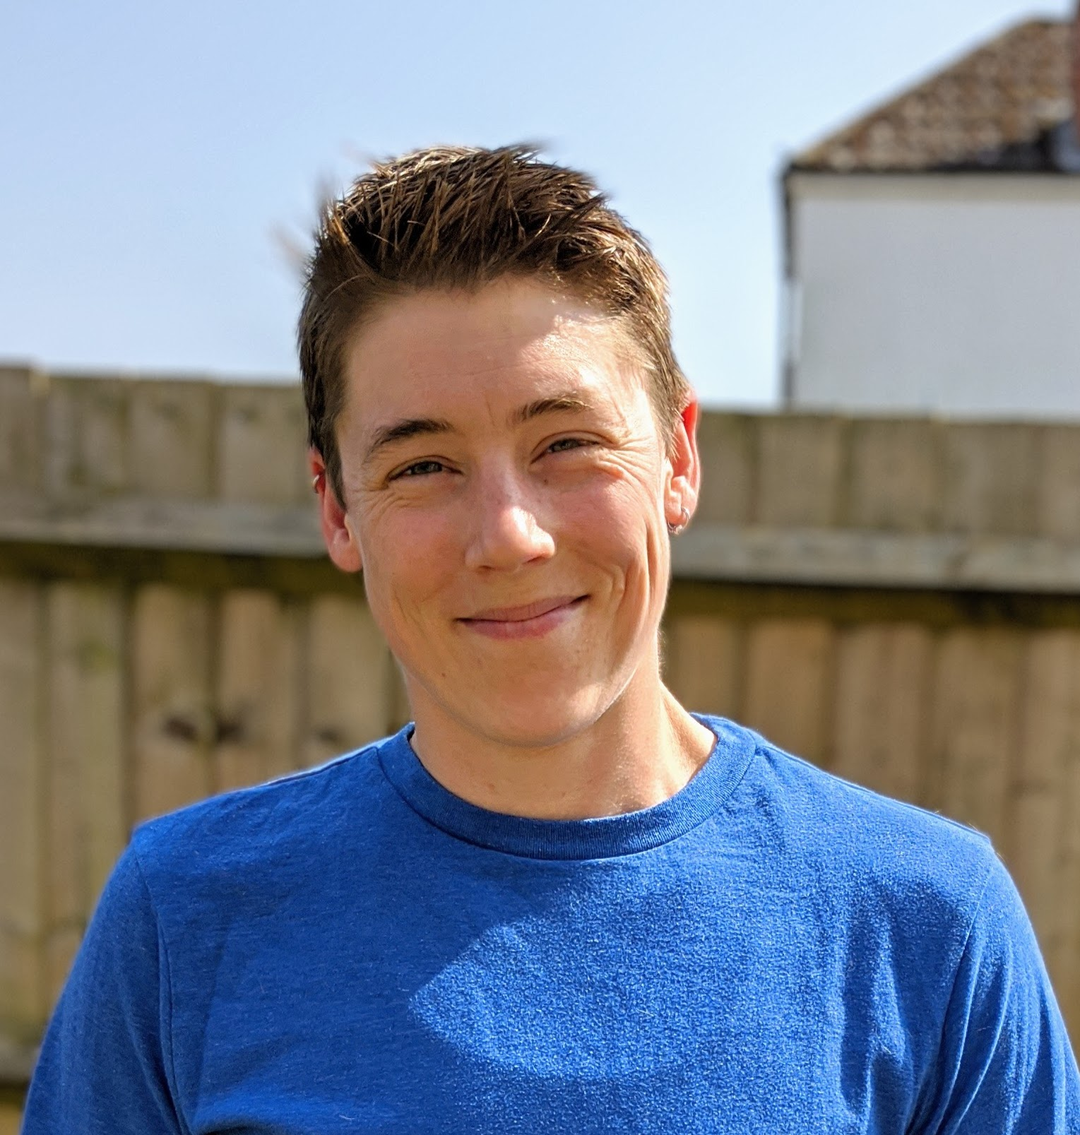




Jess Pomfret
She/Her
Passionate about
Automation
Proper Football
Fitness
Database Platform Architect Data Masterminds
beard.media/book dbatools dbachecks PowerShell & Data Community
/jpomfret
@jpomfret
jesspomfret.com

Slide 6
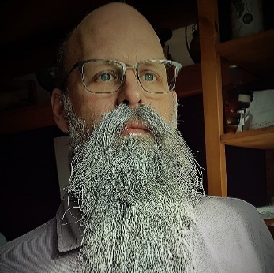
Rob Sewell
He/Him
Bearded Consultant
Automator
Trainer
Consultant Sewells Consulting Ltd
beard.media/book dbachecks PowerShell & Data Community
/robsewellsqldba
@sqldbawithbeard
blog.robsewell.com

Slide 7
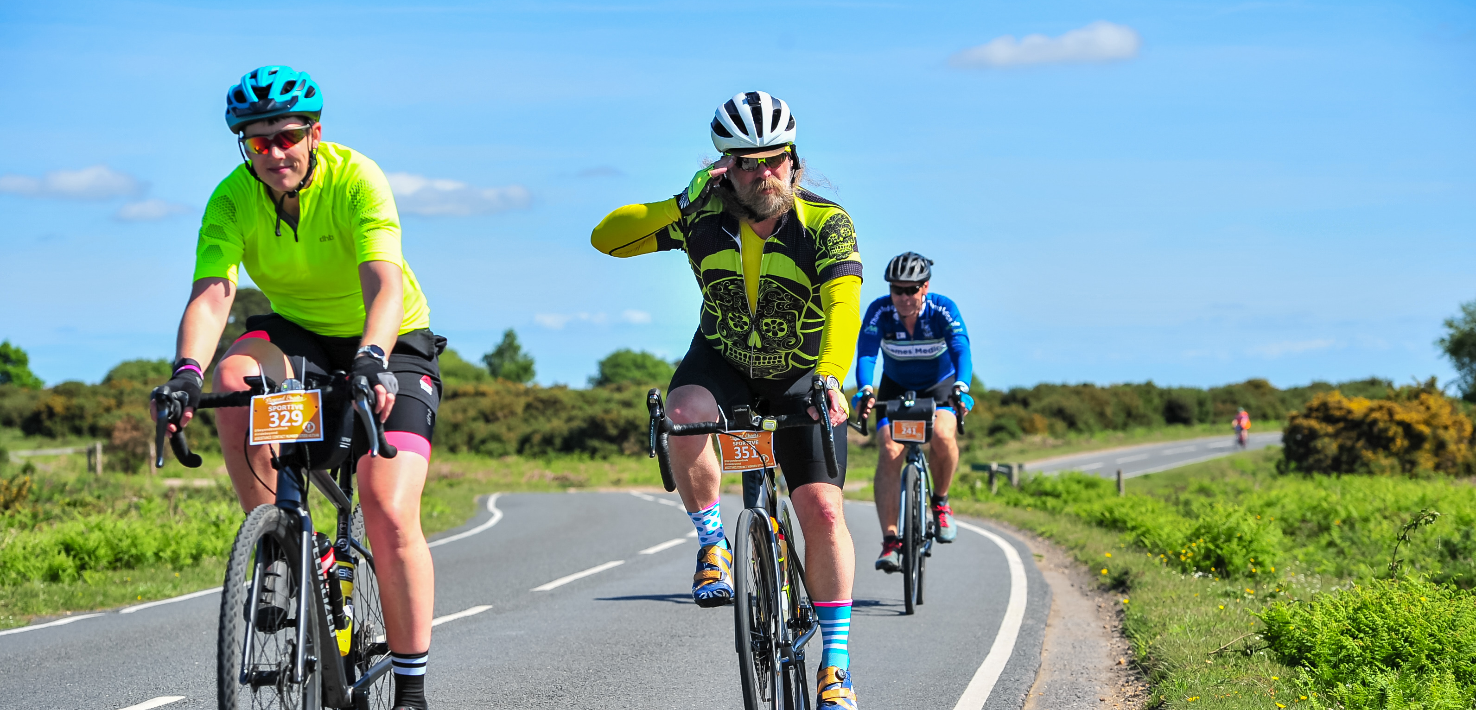
Notes:
We are not a couple, we have our own wifes

Slide 8

Register Now sqlbits.io/register
Register Now sqlbits.io/register
Agenda
sqlbits.io/agenda
sqlbits.io//training-day-agenda
Social Media sqlbits.io//youtube
sqlbits.io//twitter
sqlbits.io//mastodon
sqlbits.com

Slide 9
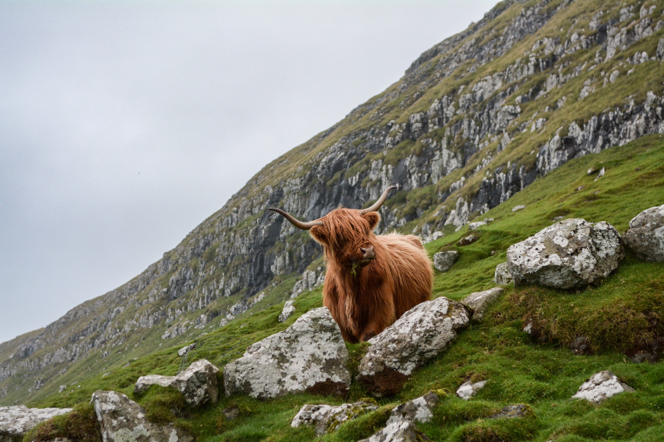
Why?
Photo by Eric Welch on Unsplash

Slide 10
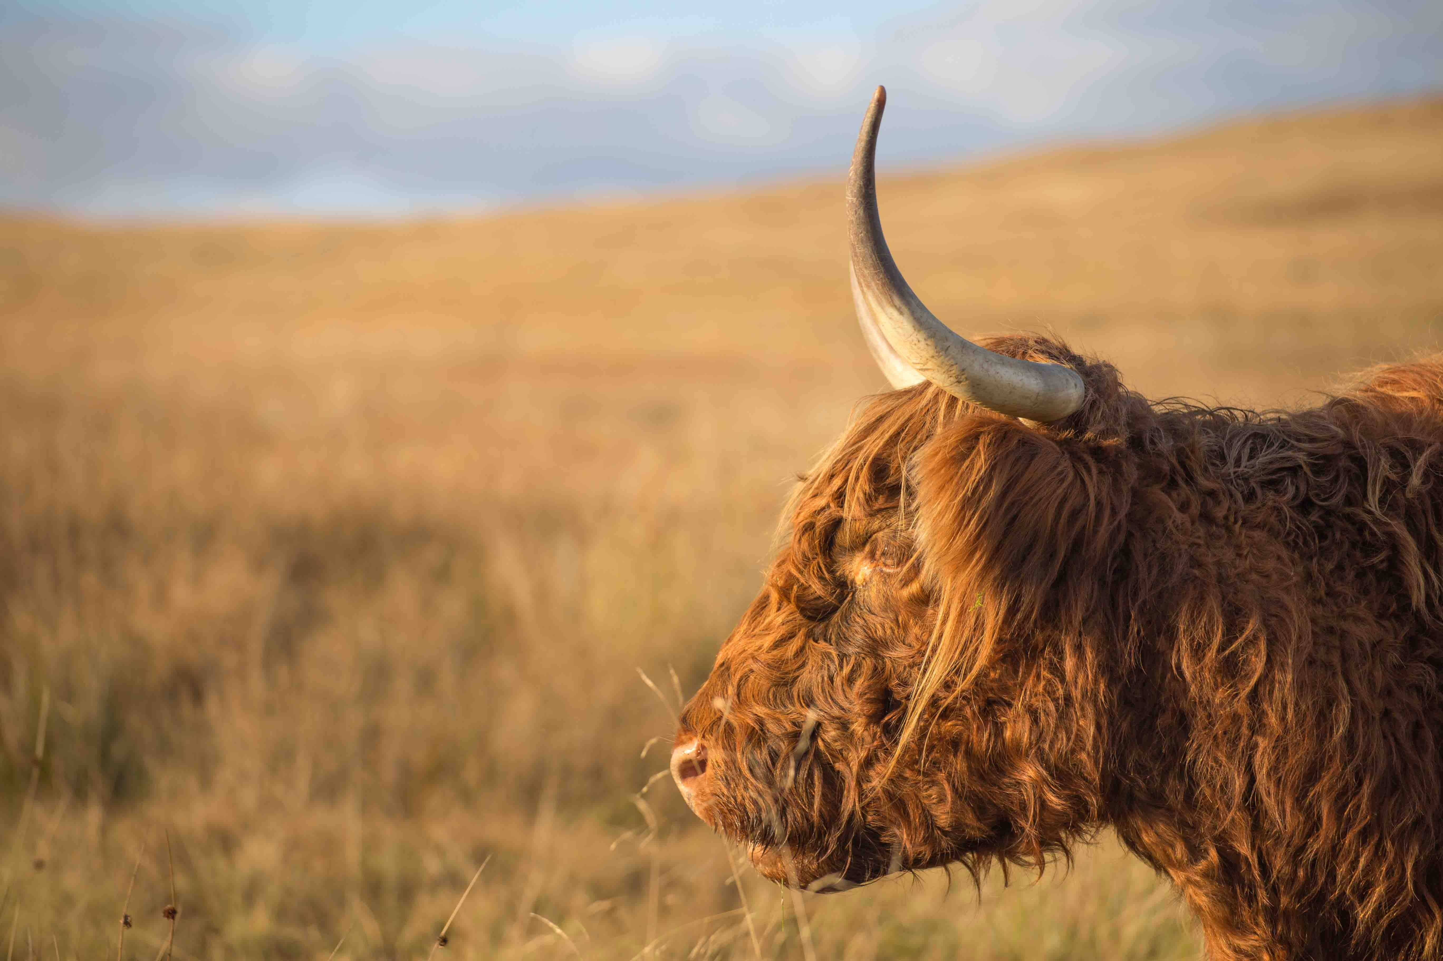
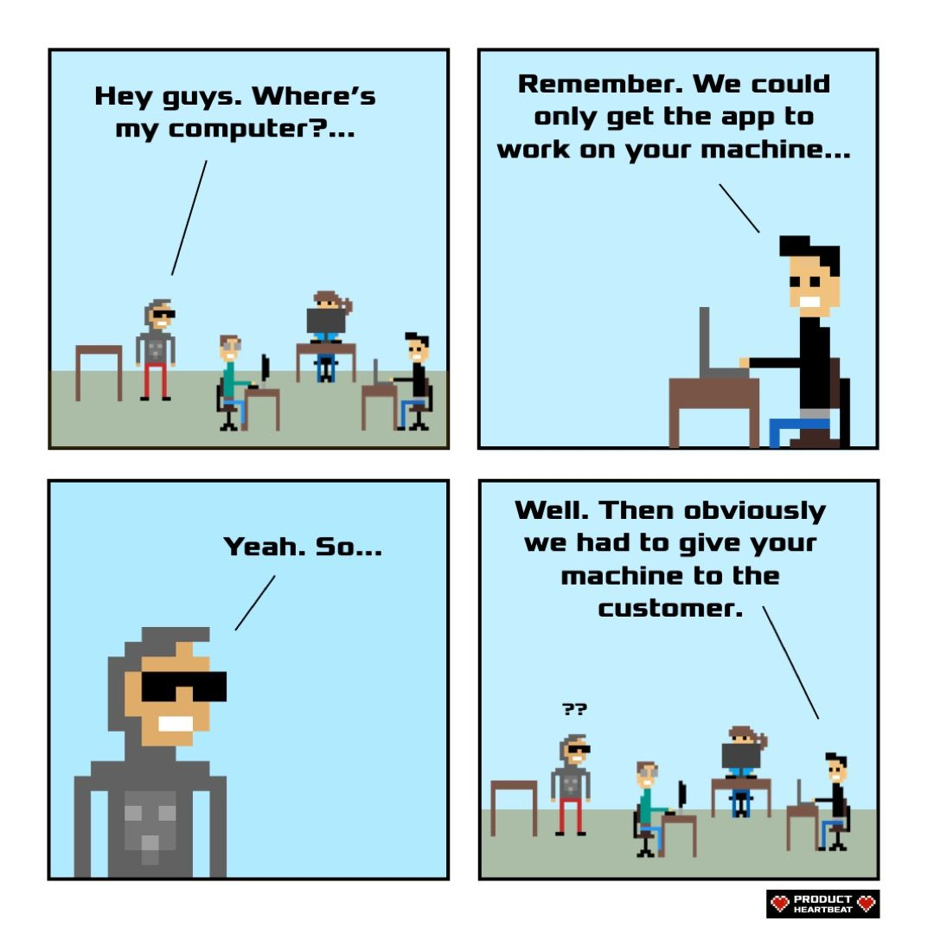
Product Heartbeat - Comics - Works on my machine
Photo by Rebecca Prest on Unsplash

Slide 11
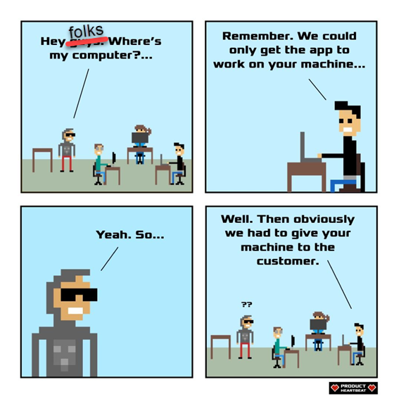
Product Heartbeat - Comics - Works on my machine
Photo by Rebecca Prest on Unsplash

Slide 12
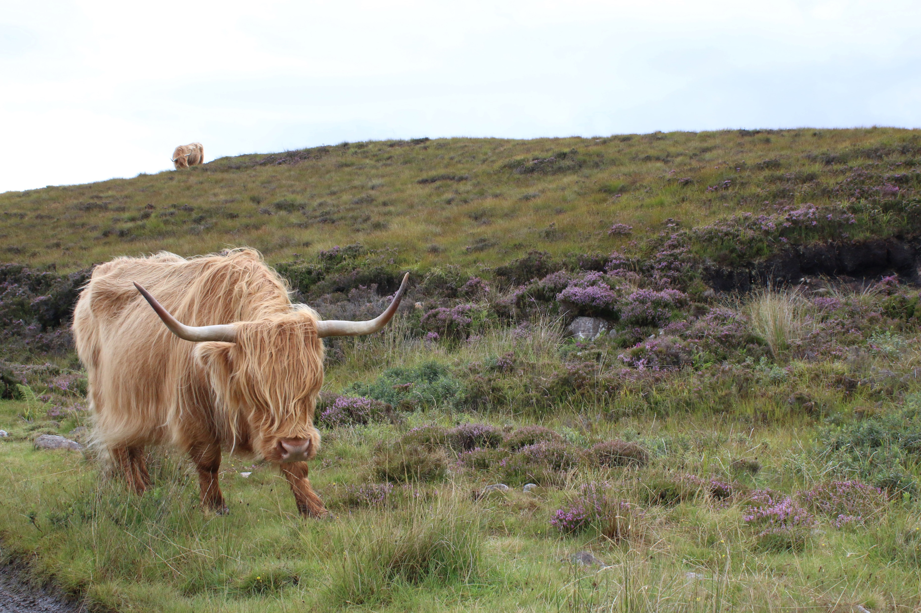
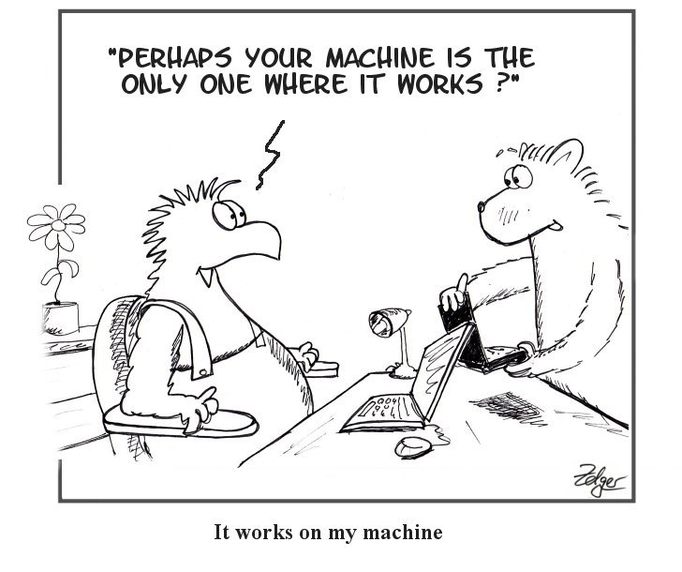
Simply the Test: IWOMM - It Works on My Machine (simply-the-test.blogspot.com)
Photo by Marta Smith on Unsplash

Slide 13
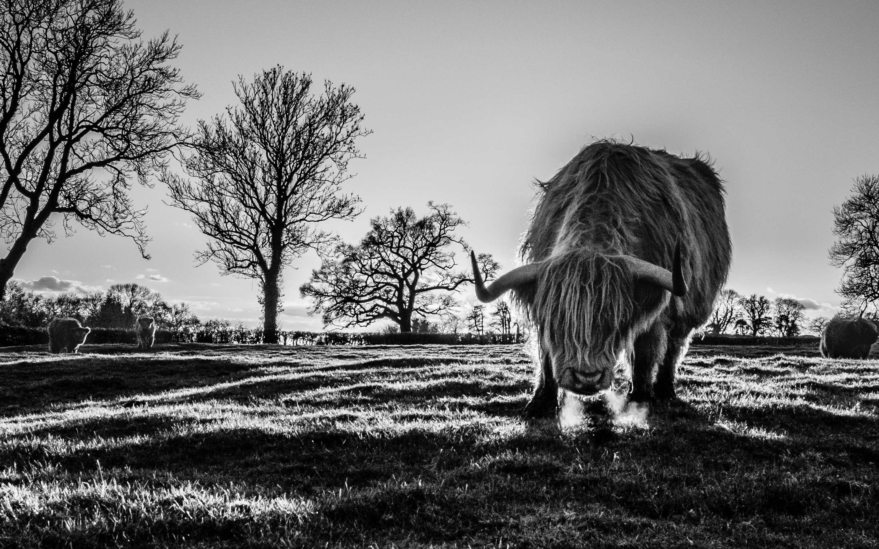
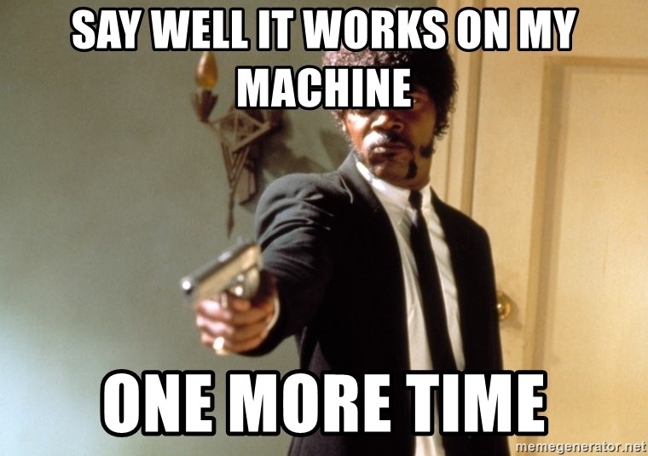
Photo by Frank Busch on Unsplash

Slide 14
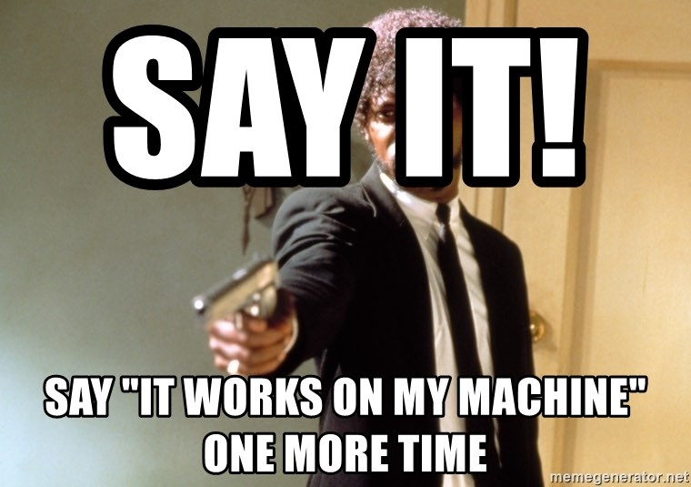
Photo by Frank Busch on Unsplash

Slide 15
Photo by Frank Busch on Unsplash

Slide 16

Identical
So that everyone is able to have the same experience and able to concentrate on developing rather than setting up.
Photo by Jan Antonin Kolar on Unsplash
Notes:
Rob
Want the same environment for everyone and both of us without issues under our control
- Having the same extensions for example – Jess had Git graph and Rob didnt

Slide 17
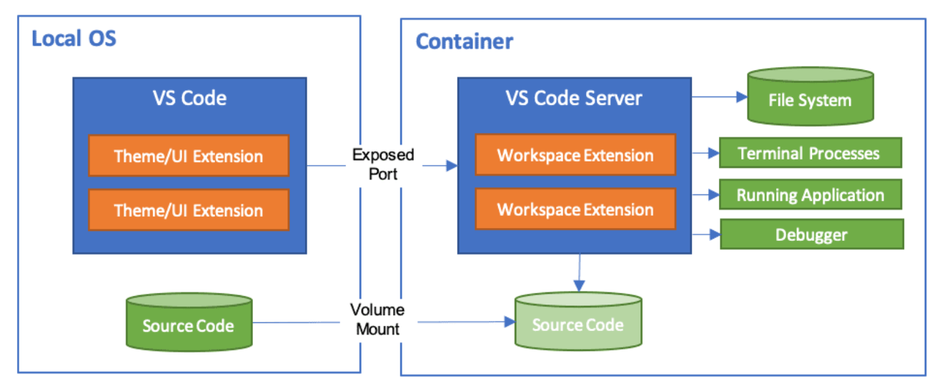

Dev Container
code.visualstudio.com/docs/remote/containers
Notes:
Jess
Run VSCode locally and connect to
a docker container as a remote server
Setup the environment as code – then it can be used by anyone
Include vs extensions
Mount source code folder into container
Can install things inside the container that you need – and not have to install on your desktop
We have options for how we setup dev container
Could use ‘post create command’ in devcontainer.json
Or could bake it into the container image and build the devcontainer from that image

Slide 18
Dev Container
code.visualstudio.com/docs/remote/containers
Notes:
Jess
Run VSCode locally and connect to
a docker container as a remote server
Setup the environment as code – then it can be used by anyone
Include vs extensions
Configuration as code
Mount source code folder into container
Can install things inside the container that you need – and not have to install on your desktop
We have options for how we setup dev container
Could use ‘post create command’ in devcontainer.json
Or could bake it into the container image and build the devcontainer from that image

Slide 19
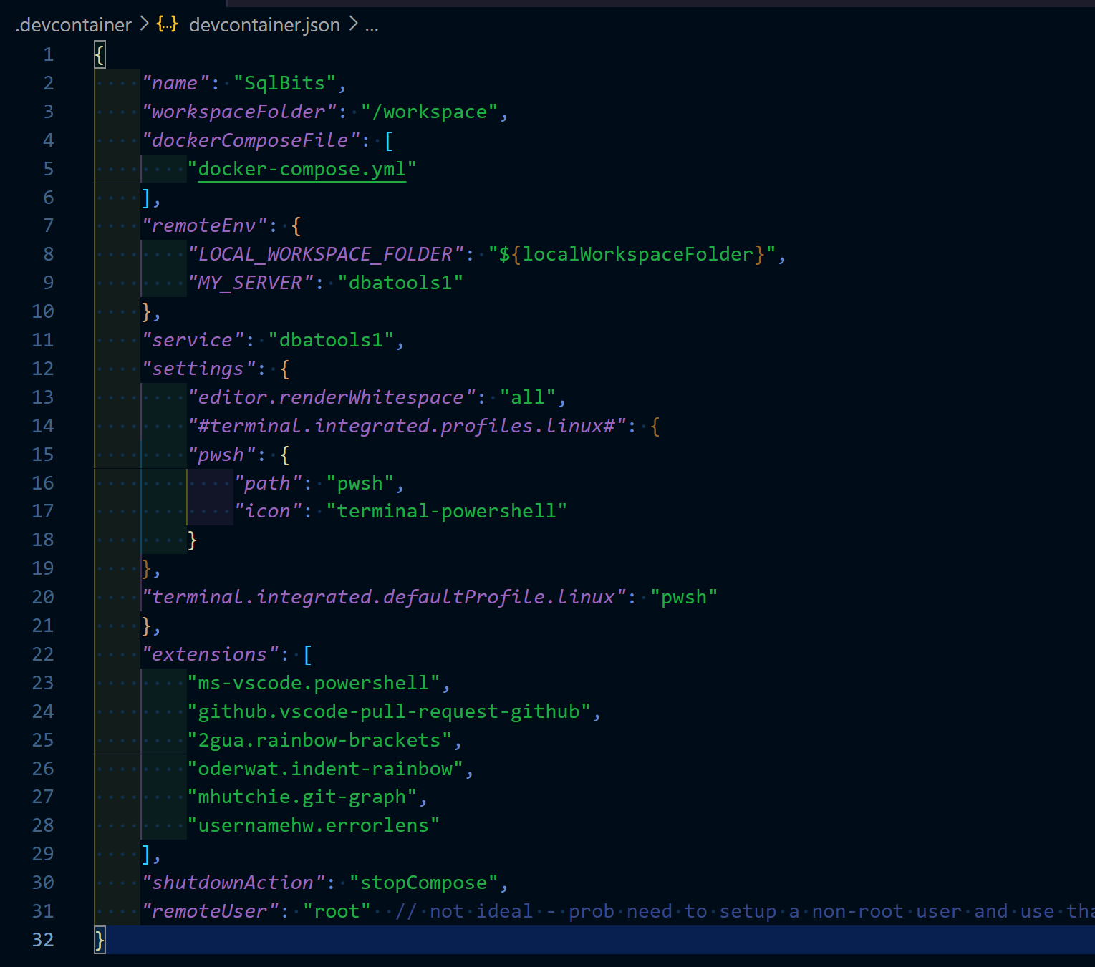
devcontainer.json
Notes:
Jess
Just add a devcontainer.json and set it up how you want your environment to be
Anybody that opens the repo in VsCode – it’ll see this devcontainer.json file and prompt you to open in container – we’ll point that out in the demo
Workspace folder – where it’ll end up
Service – is where we want to go - ‘the service you want to work on’
Extensions –

Slide 20
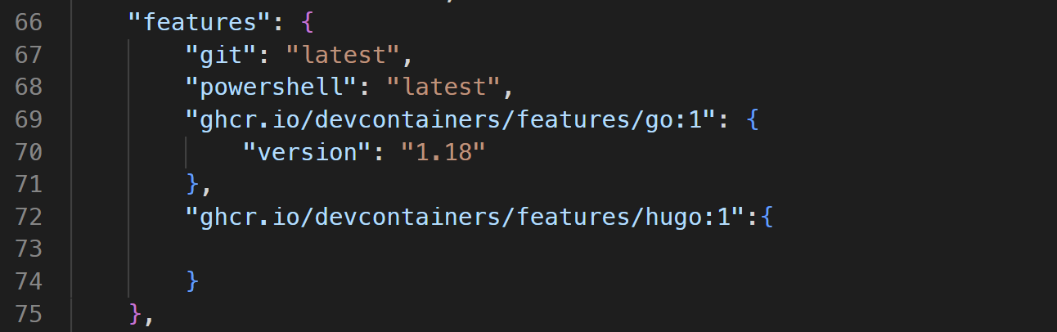
Features
self-contained, shareable units of installation code and development container configuration.

Slide 21
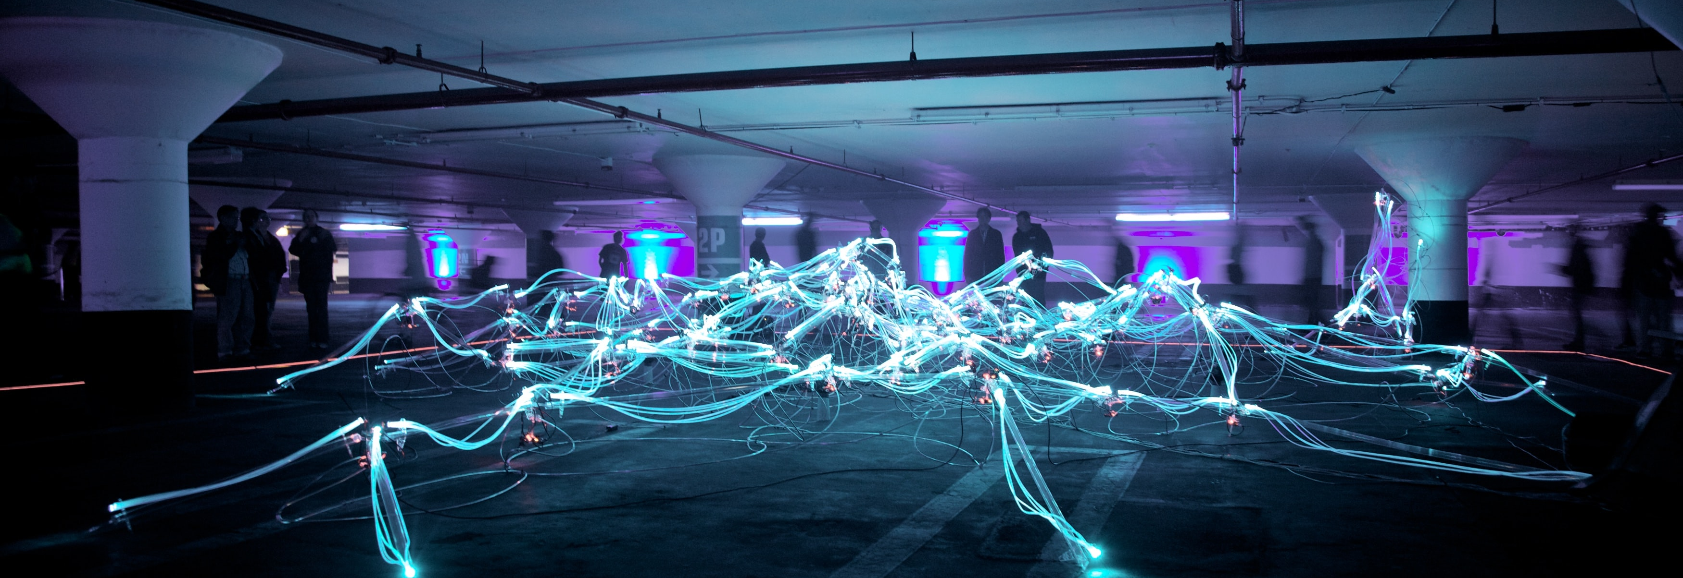
Updating
Photo by Marius Masalar on Unsplash
Notes:
Rob - We are not animals

Slide 22
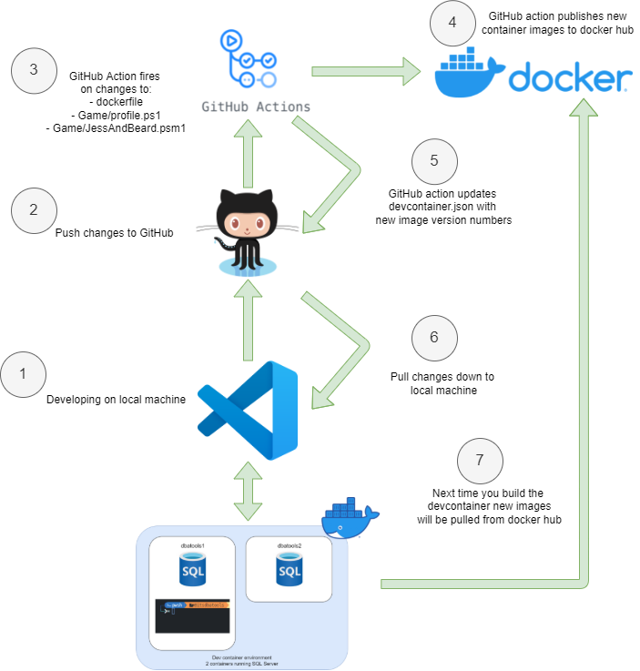
Development Workflow
Notes:
Jess
Docker image tags
Then the devcontainer will notice the configurations changed and when we rebuild it’ll pull new images

Slide 23
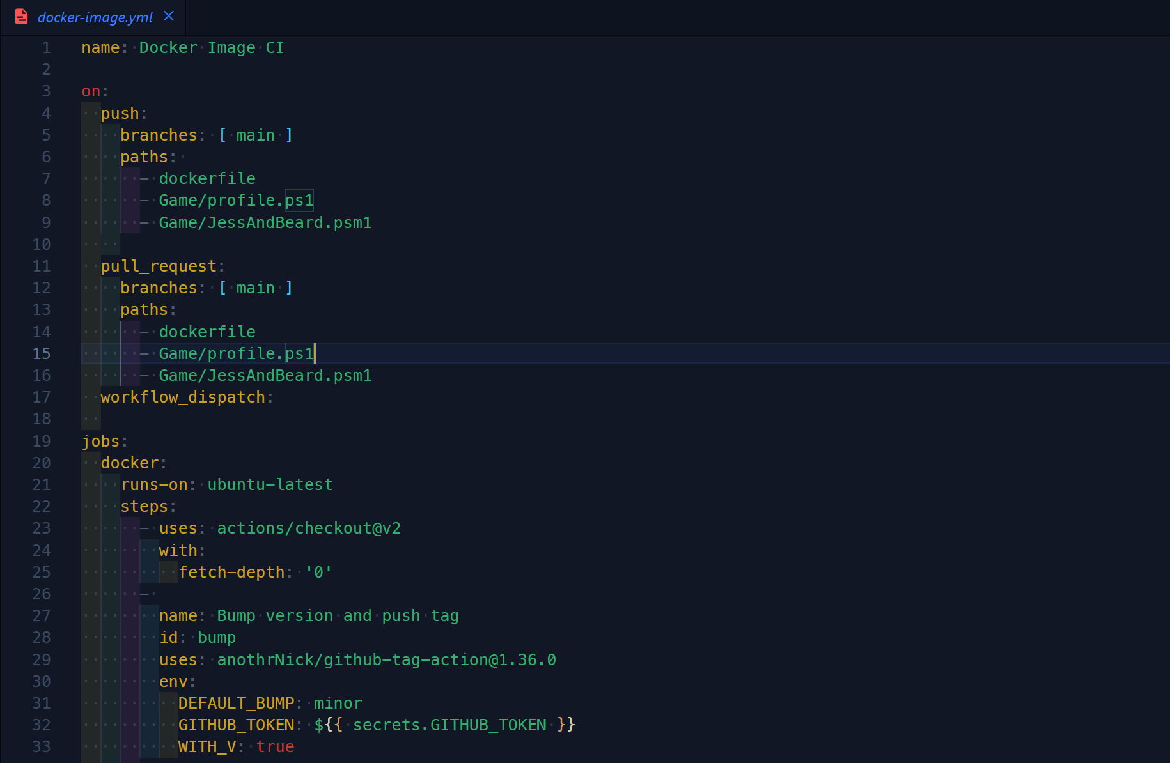
GitHub workflow
Notes:
Jess
On push paths – certain files that meant we wanted to rebuild container
Workflow_dispatch – so we can run it manually
Bump version

Slide 24
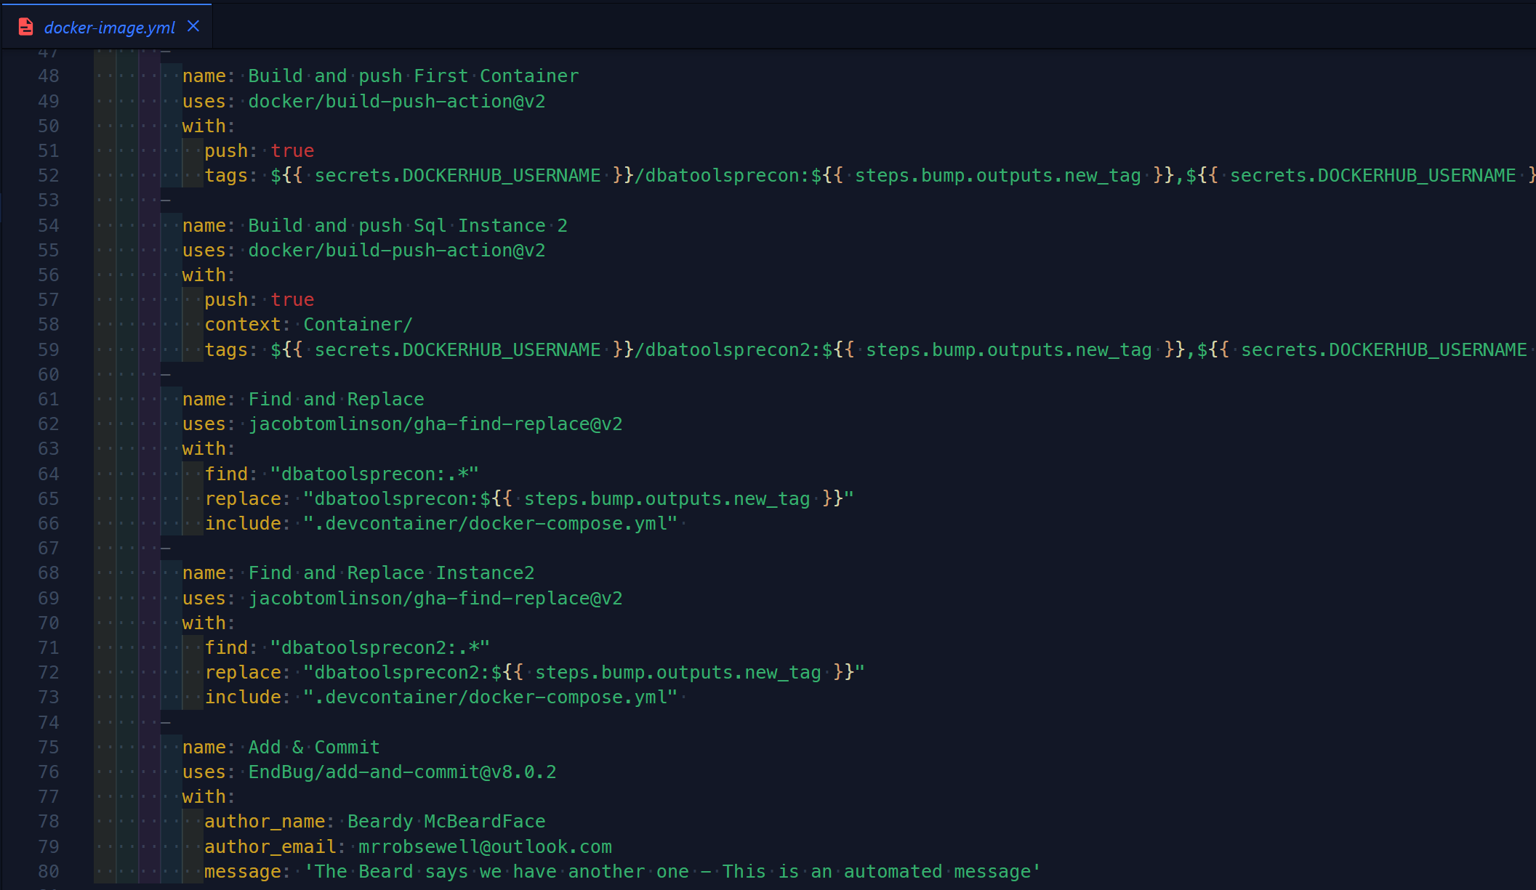
GitHub workflow
Notes:
Jess
Github secrets – following best practices not to store credentials in our repo
Build-push-action – pushes containers to docker repo
Find & replace – 2 steps – couldn’t be bothered with the regex
Add & commit

Slide 25
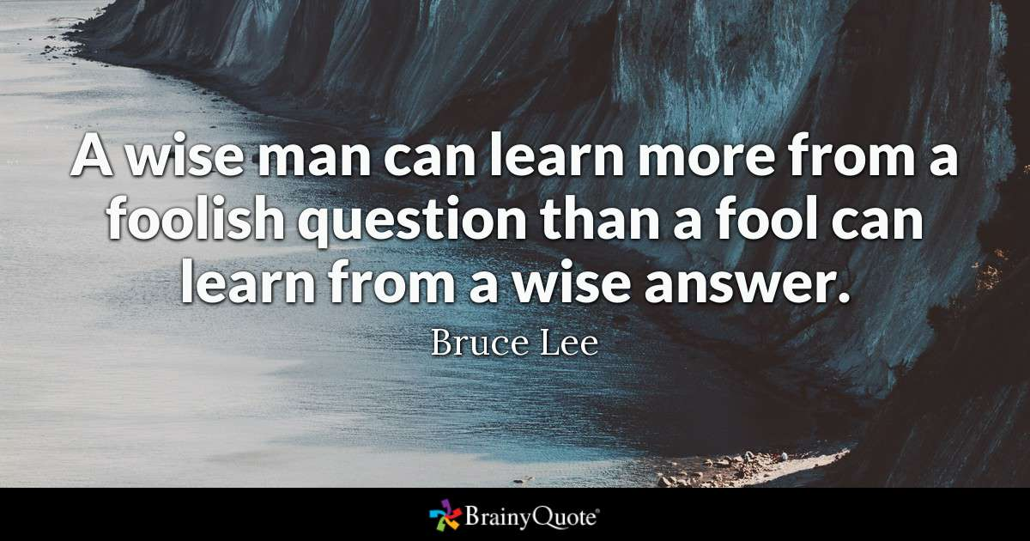

Slide 26



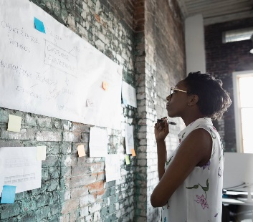
Thank you
Rob Sewell
@sqldbawithbeard
Jess Pomfret
@jpomfret
Notes:
MANDATORY SLIDE – “Please use the QR code to provide session feedback.”

